Slide 1

Build AI Agents in Azure Azure AI Agent Service
Dave Glover
Principal AI Cloud Developer Advocate | Microsoft
LinkedIn: https://www.linkedin.com/in/gloveboxes
GitHub: https://github.com/gloveboxes

Slide 2

Use case
Working for an e-commerce selling camping equipment
Want to analyze sales data
Notes:
We're an outdoor and hiking equipment company and sell online
We'll use the power of AI to analyze our sales data
Reimaging a UX with GenAI that our sales team can use

Slide 3
Agent
Semi-autonomous software that can be given a goal and will work to achieve that goal without you knowing in advance exactly how it's going to do that or what steps it's going to take.
Notes:
Keep it simple
So, what differentiates AI conversations and Agents
There are many definitions of an Agent
This is the definition we’ve settled on.
Simple as data analysis
Complex as onboarding a new hire
Semi-autonomous software that can be given a goal and will work to achieve that goal without you knowing in advance exactly how it's going to do that or what steps it's going to take.

Slide 4

An agent needs to accomplish 3 things:
Reason over a provided business process
Retrieve context to complete the process
Perform an action for the end-user
Notes:
In short, an agent should be able to accomplish 3 things:
Reason over a provided business process
Integrate with data sources for context
Orchestrates a process towards achieving a goal by performing actions
An LLM-based agent is a framework that sits above one or more models that allows you to do complex long running tasks and that can take action on your behalf.

Slide 5
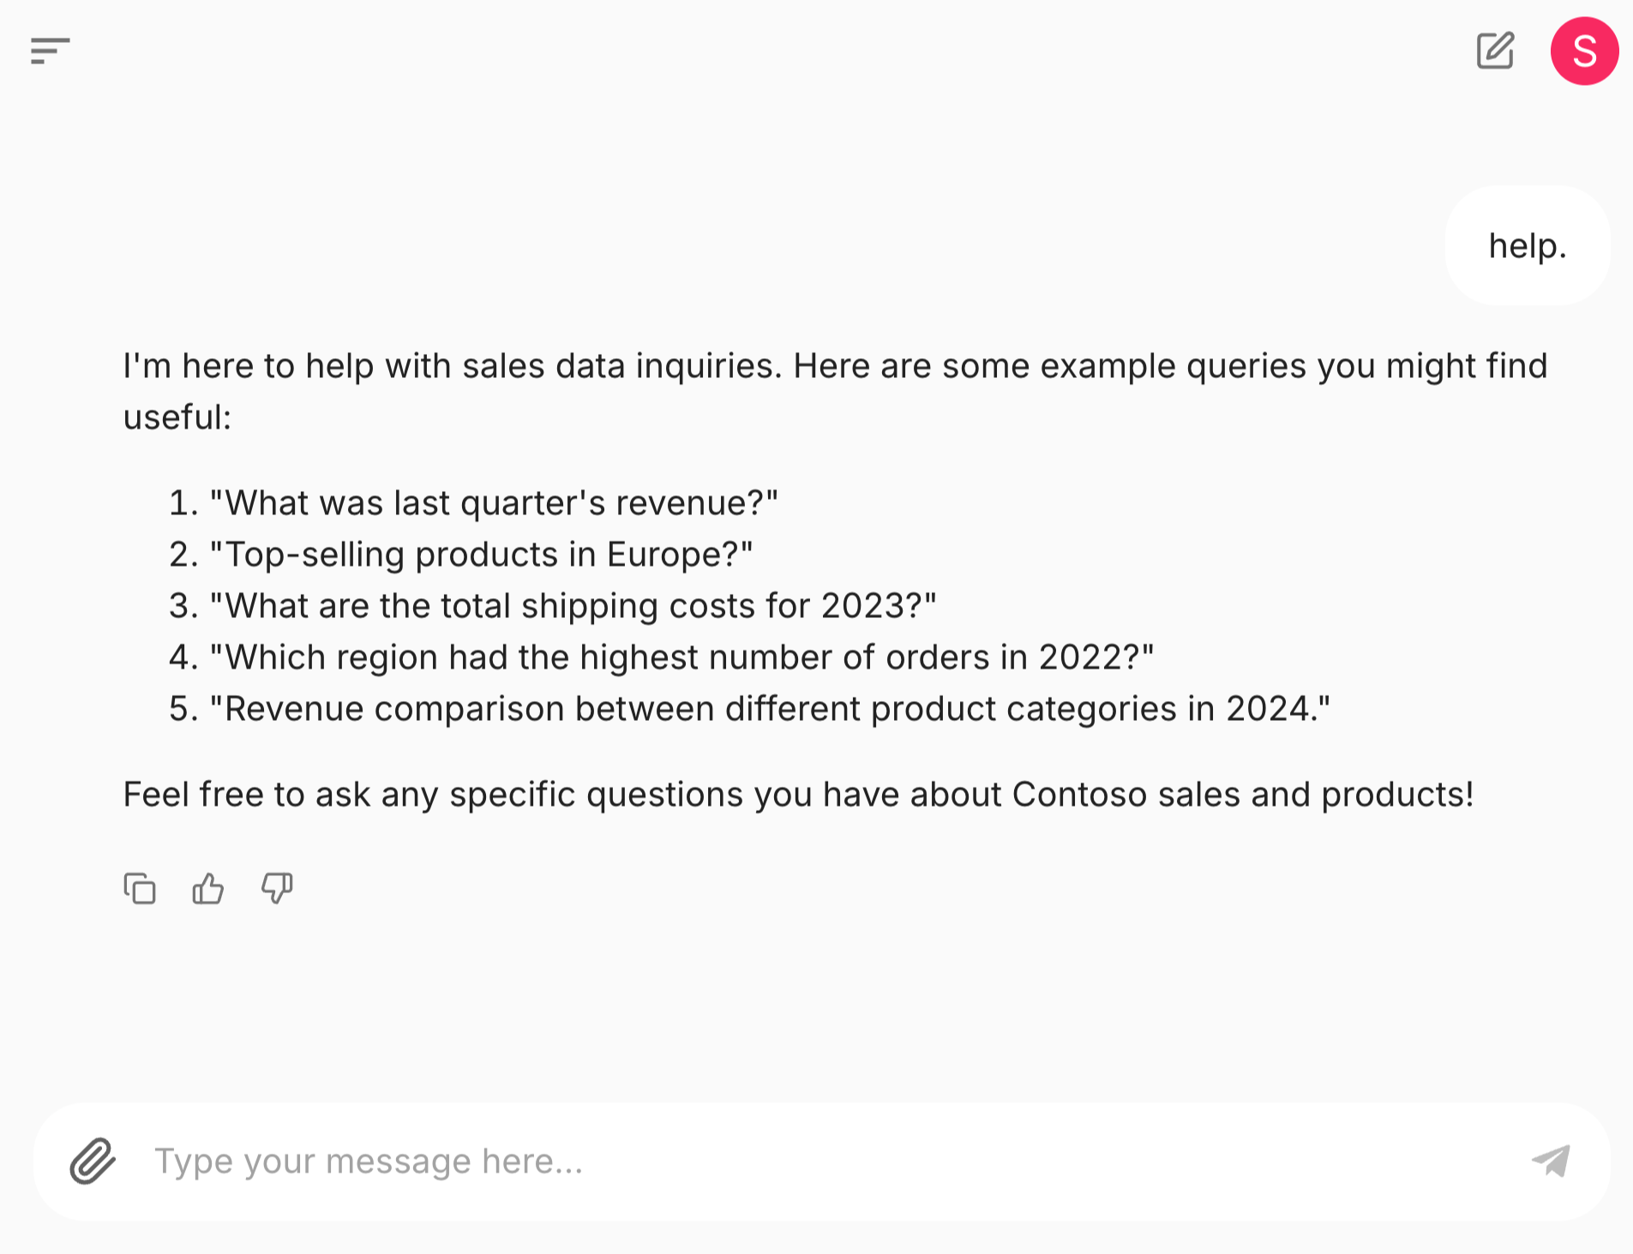
Demo – Contoso Sales Agent
An agent built with Chainlit and the Azure AI Agent Service (Demo 1)
Notes:
What’s interesting
NLP
Dynamic SQL Generation
Orchestration
Integration
Emphasis
Read only database
Simplify data structures for be user query friendly
ETL (extract transform and load) from production systems to a data warehouse for data analysis
In traditional app dev I’d be responsible for the logic and flow of the app, but in a LLM app I’m delegating that flow to the LLM.
I’ve defined how I want the app to behave with a meta prompt and metadata
Provided the LLM with a series of tools that it uses to integrate with existing data sources to provide context to the LLM.
There are some interesting consequences testing, quality, safety, there is a lot if research into solving those problems.
This is not for all styles of apps – for example banking transaction processing systems.
https://avzj7zb4r6vc6y-ca.bluegrass-e97bed3c.swedencentral.azurecontainerapps.io/sales/
https://azure-samples.github.io/contoso-sales-azure-openai-assistants-api/conversation/
The app I am going to show you is a conversational agent that can answer questions about sales data, generate charts, and create Excel files for further analysis.
The app is built with Azure OpenAI GPT-4o , the Azure AI Agent Service and the Chainlit Conversational AI web framework to enable this UI.
The app uses a read-only SQLite Contoso Sales Database with 40,000 rows of synthetic data. When the app starts, it reads the sales database schema, product categories, product types, and reporting years, then adds this info to the Azure AI Agent Service instruction context.
The Contoso Sales Agent app is deployed to Azure using Azure Container Apps. The app is fully asynchronous, uses the FastAPI framework, and streams all responses to users in real-time.
1. As you can see, there are some prompt starters in the center of the window. So, let’s start by selecting one of those and especially the ‘Help’ starter to understand how the agent can helps us.
2. Now, let’s try with a prompt specific for the financial use case. Create a vivid pie chart of sales by region.
The LLM will first select the tool to use to address the user request, among the pre-defined tools configured when setting up the agent. So it will pick the ask_database function and generate a SQL query to use as parameter. It will then call the fetch_sales_data_using_sqlite_query
function to execute the query and return the results that you can see printed here. After that, the LLM will generate Python code to create a pie chart based on the query results and will execute it inside a Python sandbox enabled by the code interpreter tool.
3. Next, we'll ask about beginner-friendly tents. Submit the prompt: What beginner-friendly tents does Contoso sell?
The sales database has limited knowledge of the products as the focus of the database is sales data, so the LLM is not really able to help here.
4. Then, we'll going to upload a Contoso Tents Datasheet to the Agent chat. This will allow the agent to provide more detailed information about the tents. The AI Agent Service will vectorize the PDF and store the data in a vector store and the LLM will be able to access the data using hybrid (semantic and keyword) queries.
Resubmit question: What beginner-friendly tents does Contoso sell?
Now the agent has access to the tent data through a tool called File Search and can provide more detailed information.
5. Now, we're going to combine the data from the sales database and the tent datasheet to provide a more detailed analysis.
Submit the prompt: Show sales of BACKPACKING TENTS by region and include a brief description in the table about each tent.
As always, we can see the chain of thought by expanding the section of Used tools.
6. Finally, let's use the AI Agent Service, the LLM, and the code interpreter to generate a report on the sales of beginner-friendly tents in Excel format.
Submit the prompt: Create an excel file
The LLM will generate the Python code to create the Excel file. You can download the file by selecting the download link and open in Excel.

Slide 6
Chapter 2
How does the Contoso Sales Assistant work?
Notes:
There are lots of FXs to help build Agents – LangGraph, LangChain, AutoGen, SK, Crew AI
That leaves us a developers with a lot of complexity

Slide 7

Azure AI Foundry
Coming Soon
Azure AI Agent Service
Securely build, deploy, and scale AI agents with ease
Rapid development and automation
Extensive data connections
Flexible model selection
Enterprise-grade security
ai.azure.com
Notes:
We’re are going to use the newly announced Azure AI Agents Service
It addresses the complexity
Simplifies dev
State management
Context management
Integration with backend data sources
Simplifies deployment and scaling
Support for many model families
Enterprise security

Slide 8
Solution Architecture
Contoso Sales Agent App
Chainlit
Query Function
Azure AI Agent Service
Instructions
Models
Actions (Tools)
Function Calling
Code Interpreter
File Search
Grounding with Bing Search

Slide 9






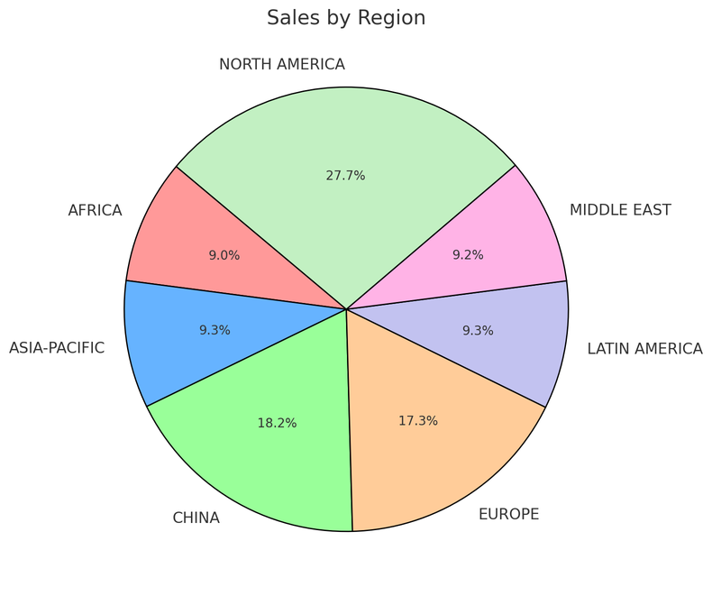
AI Agent Service in Action
Step 1: Create an Agent
Step 2: Create a Thread
Step 3: Run the Agent
Step 5: Check the Run status
Step 6: Display the Agent’s Response
Agent
Contoso Sales Agent
Instructions: You are an advanced sales analysis agent for Contoso, specializing in assisting users with sales data inquiries
Thread
Sales analysis
Run 1
User’s message
Tell me the total sales by region
1
Function Calling Tool
Query SQLite DB
Model
Agent’s message
Here is the sales:
Europe: $15478.00
America: $78792.00
2
Create message
Your data (optional)
Azure AI Search
Files (local or Azure Blob)
User’s message
Show as a pie chart
Run 2
Tools (optional)
File Search Code Interpreter
Function Calling Bing Search Microsoft SharePoint
Microsoft Fabric
Azure AI Search Azure Logic Apps
Azure Functions
OpenAPI 3.0 specified tools
1
Code Interpreter Tool
Create a pie chart
Agent’s message
2
Create message
Notes:
AI Agent Service in Action
High level – this is how the AI Agent Service works
- Create an agent, Create a Thread, Run the Agent, Check the Run status, Display the Agent’s Response
Break this down
Create the Agent
Create a thread which is a unit of conversation
Attach instructions, select a model, enable tools (file search, Code Interpreter, AI Search, Azure Functions)
Attach a user msg
Run the thread, get output
Rinse and repeat

Slide 10
Function calling
The capability of LLMs to take in ​
user-defined functions as inputs & generate structured outputs.
Notes:
Now we’re going to look at some of the building blocks
OpenAI and other models support function calling
You provide a definition of a function call
If the LLM detects conversation that would satisfy a function, you get structured output
It’s then up to your app to decide what to do with the structured data
In this case execute a SQL query and return data as context to the model

Slide 11
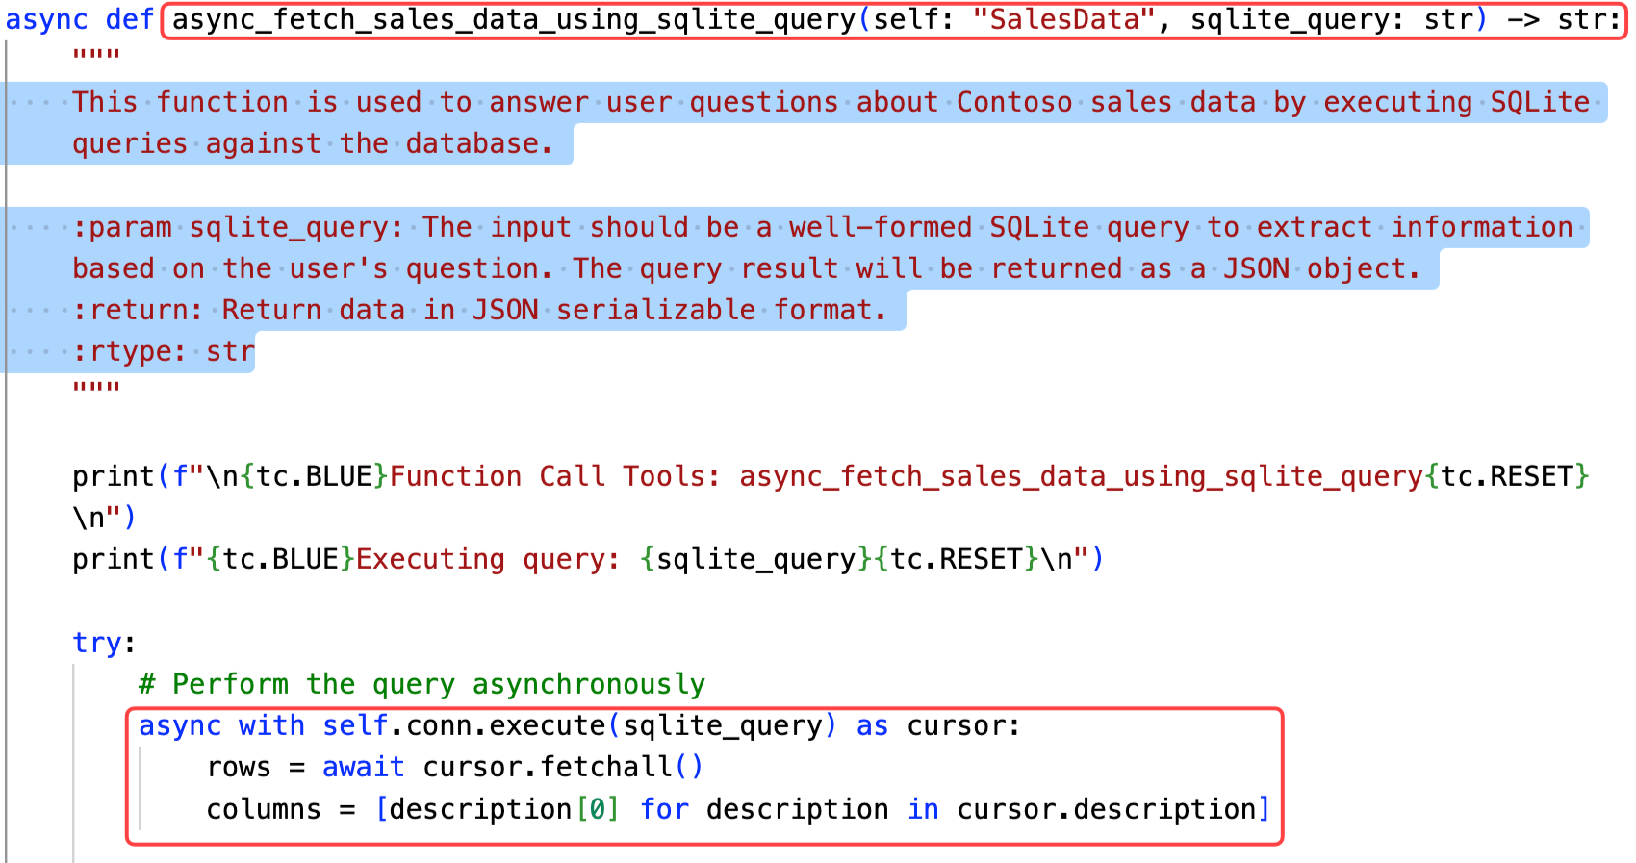
Function Calling
Instruction
User
LLM
You are a sales analysis agent for Contoso. You get all the sales data from this app using the functions provided. Use the database {metadata} when writing SQL queries.
Function
name = async_fetch_sales_data_using_sqlite_query’
args = {​ “query": “SELECT Revenue FROM sales WHERE month = 4 and year = 2023” }​
What were the sales for April 2023?
Notes:
Let’s do an example, using again our Contoso Sales Agent scenario.
So the process is:
1. Call the chat completions API with your functions and the user’s input + any system message. In this example we have the definition of a get sales by month function as a json with the corresponding list of parameters expected, in this case month and year.
2. Use the model’s response to call your API or function. When you call the model with a prompt built in this way, you’ll get as output a json response similar to this one, that you can directly use to call the get sales month function
3. Call the chat completions API again, including the response from your function to get a final response

Slide 12
Lab 1 Demo
Function Calling and Dynamic SQL Generation
Notes:
https://microsoft.github.io/build-your-first-agent-with-azure-ai-agent-service-workshop/lab-1-function_calling/

Slide 13
Lab 2 Demo
Grounding with File Search
Notes:
https://microsoft.github.io/build-your-first-agent-with-azure-ai-agent-service-workshop/lab-2-file_search/

Slide 14
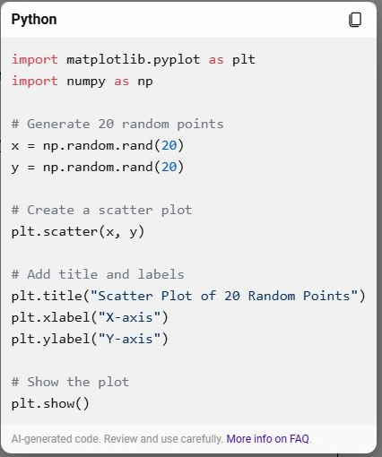
Lab 3 Demo
Code Interpreter
Notes:
https://microsoft.github.io/build-your-first-agent-with-azure-ai-agent-service-workshop/lab-3-code_interpreter/

Slide 15

Lab 4 Demo
Grounding with Bing Search
Notes:
https://microsoft.github.io/build-your-first-agent-with-azure-ai-agent-service-workshop/lab-6-bing_search/

Slide 16

Resources
https://aka.ms/aihack/agent-service/docs
https://aka.ms/aihack/agent-service/repo

